Slide 1
Copyright Notice
These slides are distributed under the Creative Commons License.
DeepLearning.AI makes these slides available for educational purposes. You may not use or distribute these slides for commercial purposes. You may make copies of these slides and use or distribute them for educational purposes as long as you cite DeepLearning.AI as the source of the slides.
For the rest of the details of the license, see https://creativecommons.org/licenses/by-sa/2.0/legalcode

Slide 2
Machine Learning
Welcome!

Slide 3








eddy
aarti
geoff
Ivy
daniel
andres
kin
robert

Slide 4


Congratulations!
You've won
Re: Urgent Information :)
a million dollars!
ື ື ື ື ື
ື
ܣ ܣ ܣ ܣ ܣ ܣ

Slide 5
Machine Learning
Applications of Machine Learning

Slide 6
Machine Learning Overview
What is Machine Learning?

Slide 7
Machine learning
“Field of study that gives computers the ability to learn without being explicitly programmed.”
Arthur Samuel (1959)

Slide 8


Question
If the checkers program had been allowed to play only ten games (instead of tens of thousands) against itself, a much smaller number of games, how would this have affected its performance?
Would have made it better Would have made it worse

Slide 9
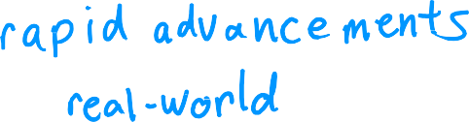














Machine learning algorithms
Supervised learning
Unsupervised learning
Recommender systems
Reinforcement learning
Practical advice for applying learning algorithms

Slide 10
Machine Learning Overview
Supervised Learning Part 1

Slide 11




Supervised learning
input
output label
Learns from being given “right answers”

Slide 12

Input (X)
Output (Y)
Application
email
spam? (0/1)
spam filtering
audio
text transcripts
speech recognition
English
Spanish
machine translation
ad, user info
click? (0/1)
online advertising
image, radar info
position of other cars
self-driving car
image of phone
defect? (0/1)
visual inspection

Slide 13

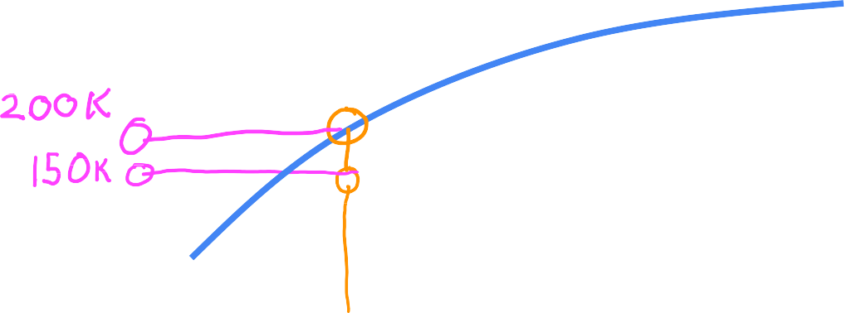














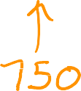
Regression: Housing price prediction
400
300
Price in
$1000's
200
100
0
0
500
1000 1500
House size in feet²
2000
2500
Regression
Predict a number
infinitely many possible outputs

Slide 14
Machine Learning Overview
Supervised Learning Part 2

Slide 15




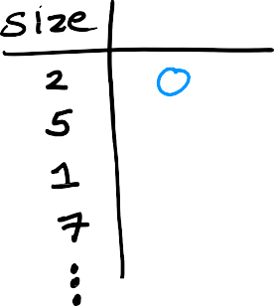






Classification: Breast cancer detection
1
0
tumor size 𝑥
(diameter in cm)
benign malignant

Slide 16












Classification: Breast cancer detection
benign
malignant
malignant type 2
0cm
diameter(cm)
10cm
Classification predict categories
small number of possible outputs

Slide 17











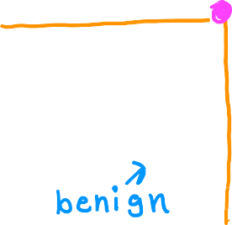




Two or more inputs
Age
Tumor size

Slide 18
Supervised learning
Learns from being given “right answers”
Regression
Predict a number
infinitely many possible outputs
Classification predict categories
small number of possible outputs

Slide 19
Machine Learning Overview
Unsupervised Learning Part 1

Slide 20

Previous: Supervised learning
Now: Unsupervised learning

Slide 21


Supervised learning Learn from data labeled with the “right answers”
Unsupervised learning Find something interesting in unlabeled data.
age
age
tumor size
tumor size

Slide 22











Clustering: Google news

Slide 23



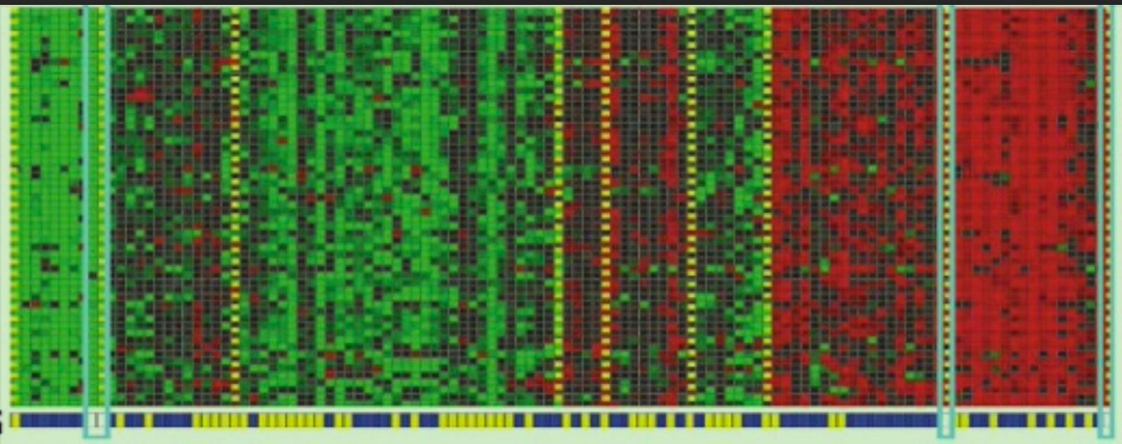







Clustering: DNA microarray
genes
(each row)
individuals
(each column)

Slide 24
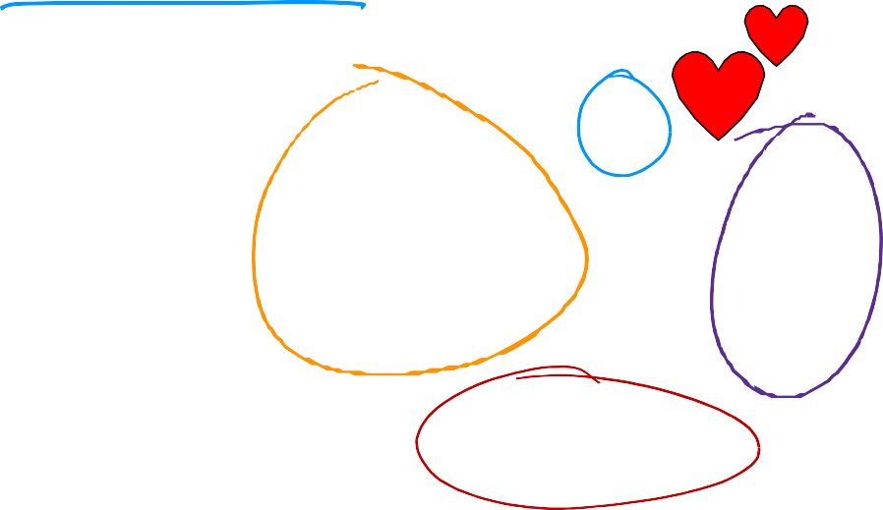

Clustering: Grouping customers
growing skills
and knowledge
develop
career
stay updated
with AI

Slide 25
Machine Learning Overview
Unsupervised Learning Part 2

Slide 26
Unsupervised learning
Data only comes with inputs x, but not output labels y.
Algorithm has to find structure in the data.
Clustering
Group similar data
points together.
Dimensionality reduction Compress data using fewer numbers.
Anomaly detection
Find unusual data points.

Slide 27






Question
Of the following examples, which would you address using
an unsupervised learning algorithm?
Given email labeled as spam/not spam, learn a spam filter.
Given a set of news articles found on the web, group them into sets
of articles about the same story.
Given a database of customer data, automatically discover market segments and group customers into different market segments.
Given a dataset of patients diagnosed as either having diabetes or not, learn to classify new patients as having diabetes or not

Slide 28
Machine Learning Overview
Jupyter Notebooks

Slide 29
Linear Regression with One Variable
Linear Regression Model Part 1

Slide 30




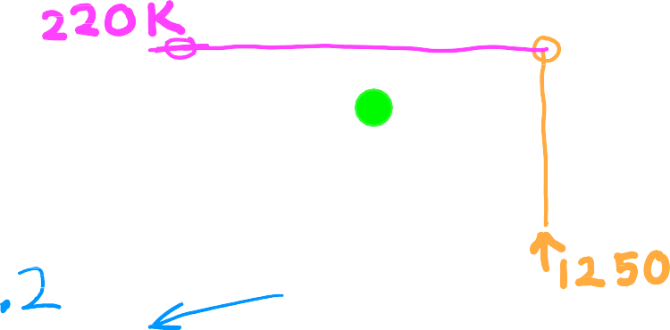









House sizes and prices
500
linear regression
400
price in
$1000's
300
200
100
0
1000
size in feet²
0
2000
3000
Regression model Predicts numbers
Supervised learning model
Data has “right answers”
Classification model
Predicts categories
Infinitely many possible outputs
Small number of possible outputs

Slide 31



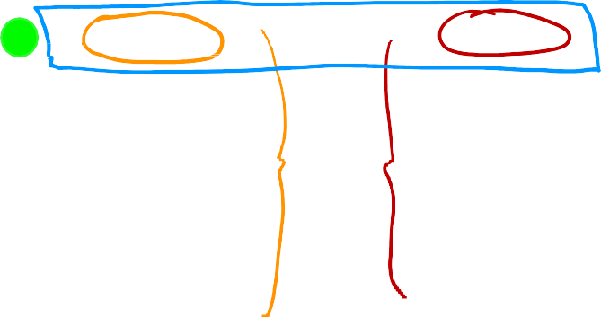



House sizes and prices
price in $1000's
Data table
size in feet² price in $1000's
500
400
2104
1416
1534
852
…
3210
400
232
315
178
…
870
300
200
100
0
0
1000
2000
size in feet²
3000

Slide 32
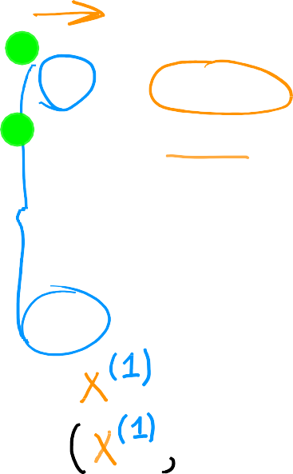




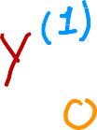



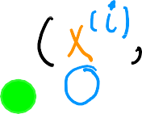
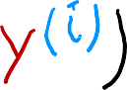
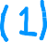

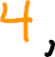



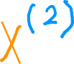


Terminology
Training Data used to train the model set:
Notation:
𝑥 = “input” variable
feature
𝑦 = “output” variable
“target” variable
𝑚 = number of training examples
𝑥
𝑦
price in $1000's
size in feet²
(1) | 2104 | 400
(2) | 1416 | 232
(3) | 1534 | 315
(4) | 852 | 178
… | … | …
(47) | 3210 | 870
= single training example
(𝑥^{(𝑖)}, 𝑦^{(𝑖)}) = i^{th} training example
index
not exponent
(1st, 2nd, 3rd …)
𝑥⁽²⁾ = 1416

Slide 33
Linear Regression with One Variable
Linear Regression Model Part 2

Slide 34

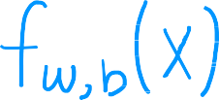




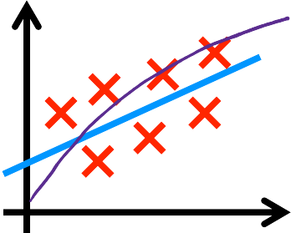














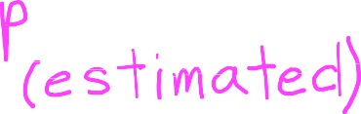



How to represent 𝑓?
training set
learning algorithm
𝑥 = 𝑤𝑥 + 𝑏
= 𝑤𝑥 + 𝑏
“y-hat”
𝑦^
^{𝑓}w,𝑏
𝑥
𝑓
𝑦
𝑓 𝑥
prediction (estimated 𝑦)
target
feature
model
𝑥
Linear regression with one variable.
Univariate linear regression.
Andrew Ng

Slide 35
Linear Regression with One Variable
Cost Function

Slide 36



Training set
size in feet² (𝑥)
price $1000's (𝑦)
Model: 𝑓_{w,𝑏} 𝑥 = 𝑤𝑥 + 𝑏
𝑤, 𝑏: parameters
2104 | 460
1416 | 232
1534 | 315
852 | 178
… | …
What do 𝑤, 𝑏 do?

Slide 37
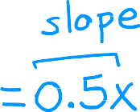




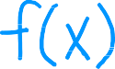


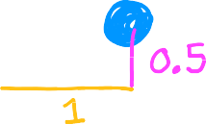






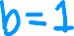









^{𝑓}w,𝑏
𝑥 = 𝑤𝑥 + 𝑏
𝑓(𝑥)
3
3
3
2
2
2
1
1
1
0
0
0
1 2
𝑤 = 0
𝑏 = 1.5
1 2
𝑤 = 0.5
b = 0
1 2
𝑤 = 0.5
𝑏 = 1
0
3
0
3
0
3

Slide 38




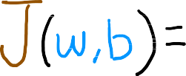
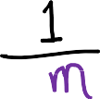
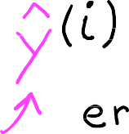
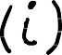









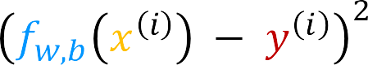









Cost function: Squared error cost function
y
_{(𝑥}(𝑖)_{, 𝑦}(𝑖)₎
^{𝑓}w,𝑏
m = number of training examples
x
𝑦^^{(𝑖)} = 𝑓_{w,𝑏}
_{𝑥} 𝑖
_{𝑥} 𝑖
= 𝑤𝑥^{(𝑖)} + 𝑏
Find 𝑤, 𝑏:
𝑦^^{(𝑖)} is close to 𝑦^{(𝑖)} for all (𝑥 ^{𝑖} , 𝑦^{(𝑖)}).
^{𝑓}w,𝑏

Slide 39
Linear Regression with One Variable
Cost Function Intuition

Slide 40





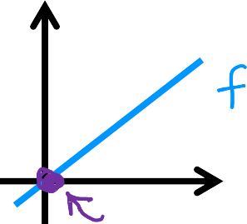
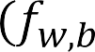
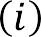


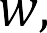

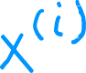

model:
simplified
𝑓_{w} 𝑥 = 𝑤𝑥
^{𝑓}w,𝑏
𝑥 = 𝑤𝑥 + 𝑏
parameters:
𝑤, 𝑏
cost function:
𝑤
goal:
minimize 𝐽 𝑤, 𝑏
w,𝑏
minimize 𝐽 𝑤
w

Slide 41











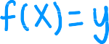
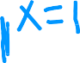

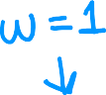


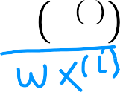


𝑓_{w}(𝑥)
(for fixed w, function of 𝑥)
input
𝐽(𝑤)
(function of 𝑤)
parameter
3
𝑓_{w}
3
2
y
1
0
2
𝑤 = 1
𝐽(𝑤)
1
0
0
1
1
x
_{𝑥} 𝑖
2
3
-0.5 0 0.5 1 1.5 2 2.5
𝑤
𝑚
𝑚
1
∑(𝑤𝑥 ^{𝑖} − 𝑦 ^{𝑖} )²
𝑖=1
1
𝐽(𝑤) =
∑(𝑓
− 𝑦 ^{𝑖} )² =
= ( 0² +0² +0² ) = 0
2𝑚
w
2𝑚
2𝑚
𝑖=1

Slide 42







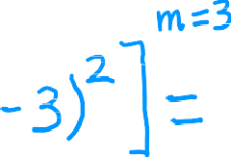
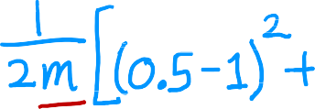
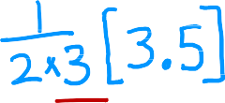

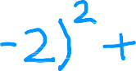




𝑓_{w}(𝑥)
(function of 𝑥)
𝐽(𝑤)
(function of 𝑤)
3
𝑓_{w}(𝑥)
3
2
2
y
𝐽(𝑤₁)
1
1
𝑤 = 0.5
0
0
0
1
2
3
-0.5
0 0.5 1 1.5 2 2.5
𝑤
x
𝐽 0.5 =

Slide 43







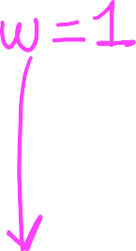







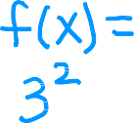

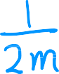
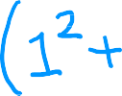
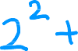
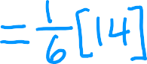





𝑓_{w}(𝑥)
(function of 𝑥)
𝐽(𝑤)
(function of 𝑤)
3
𝑓_{w}
3
2
2
y
𝐽(𝑤)
1
1
𝑤 = 0
0
0
0
1
2
3
-0.5
0 0.5 1 1.5 2 2.5
𝑤
x
𝐽 0 =

Slide 44
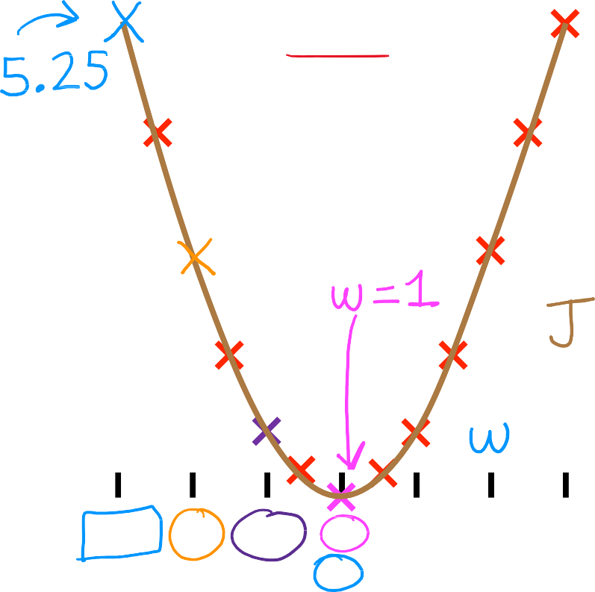



goal of linear regression:
𝐽(𝑤)
(function of 𝑤)
3
minimize 𝐽 𝑤
w
general case:
minimize 𝐽 𝑤, 𝑏
w,𝑏
2
𝐽(𝑤)
1
0
-0.5
0 0.5 1 1.5 2 2.5
𝑤

Slide 45
Linear Regression with One Variable
Visualizing the Cost Function

Slide 46

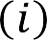

𝑥 = 𝑤𝑥 + 𝑏
Model
^{𝑓}w,𝑏
Parameters
𝑤, 𝑏
Cost Function
Objective
minimize 𝐽 𝑤, 𝑏
w,𝑏

Slide 47
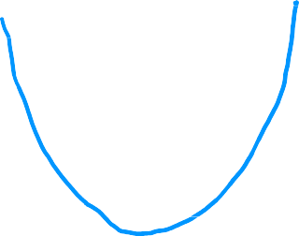






^{𝑓}w,𝑏
𝐽
(function of 𝑥)
(function of 𝑤, 𝑏)
500
400
300
price in
$1000's
200
100
0
0
1000 2000
size in feet²
3000
^{𝑓}w,𝑏
𝑥 = 0.06𝑥 + 50

Slide 48



^{𝐽}(w,𝑏)
𝐽 w = −10, 𝑏 = −15

Slide 49




3D surface plot

Slide 50


Slide 51


Slide 52










click within this plot to add points
pric e in
$1000's
size in feet²
 | you can rotate this figure

Slide 53
Linear Regression with One Variable
Visualization examples

Slide 54










click within this plot to add points
pric e in
$1000's
size in feet²
 | you can rotate this figure

Slide 55





click within this plot to add points
pric e in
$1000's
size in feet²
 | you can rotate this figure

Slide 56




click within this plot to add points
pric e in
$1000's
size in feet²
you can rotate this figure

Slide 57







click within this plot to add points
pric e in
$1000's
size in feet²
you can rotate this figure

Slide 58
Training Linear Regression
Gradient Descent

Slide 59














𝐽 𝑤, 𝑏
Have some function
Want
min 𝐽 𝑤, 𝑏
w,𝑏
min
w₁, …,w_{𝑛},𝑏
𝐽 𝑤₁, 𝑤₂, … , 𝑤_{𝑛}, 𝑏
Outline:
Start with some 𝑤, 𝑏
(set 𝑤=0, 𝑏=0)
Keep changing 𝑤, 𝑏 to reduce 𝐽 𝑤, 𝑏
Until we settle at or near a minimum

Slide 60
















𝐽 𝑤, 𝑏
𝑏
𝑤

Slide 61
Training Linear Regression
Implementing Gradient Descent

Slide 62
























Gradient descent algorithm
Assignment
Truth assertion
Repeat until convergence
Learning rate Derivative
Simultaneously update w and b
Code
Math
a==c
Correct: Simultaneous update
𝜕
𝑡𝑚𝑝_𝑤 = 𝑤 − 𝛼 _{𝜕𝑤} 𝐽 𝑤, 𝑏
Incorrect
𝜕
𝑡𝑚𝑝_𝑤 = 𝑤 − 𝛼 𝐽 𝑤, 𝑏
𝜕𝑤
𝜕
𝑡𝑚𝑝_b = 𝑏 − 𝛼 𝐽 𝑤, 𝑏
𝑤 = 𝑡𝑚𝑝_w
𝜕
𝜕𝑏
𝑡𝑚𝑝_𝑏 = 𝑏 − 𝛼 𝐽 𝑤, 𝑏
𝜕𝑏
𝑏 = 𝑡𝑚𝑝_𝑏
𝑤 = 𝑡𝑚𝑝_𝑤
𝑏 = 𝑡𝑚𝑝_𝑏
Andrew Ng

Slide 63
Training Linear Regression
Gradient Descent Intuition

Slide 64



Gradient descent algorithm
repeat until convergence {
𝐽 𝑤
min 𝐽 𝑤
w

Slide 65
















J(w)
𝐽 𝑤
𝑤
𝑤 = 𝑤 − 𝛼 ∙
𝑝𝑜𝑠𝑖𝑡𝑖𝑣𝑒 𝑛𝑢𝑚𝑏𝑒𝑟
J(w)
𝑑
𝐽 𝑤
𝐽 𝑤
𝑑𝑤
𝑤 = 𝑤 − 𝛼 ∙
𝑛𝑒𝑔𝑎𝑡𝑖𝑣𝑒 𝑛𝑢𝑚𝑏𝑒𝑟
𝑤

Slide 66
Training Linear Regression
Learning Rate

Slide 67


𝑤 = 𝑤 − 𝛼
𝑑
𝐽 𝑤
𝑑𝑤
𝐽(𝑤)
minimum
If 𝛼 is too small…
Gradient descent may be slow.
𝑤
If 𝛼 is too large…
Gradient descent may:
Overshoot, never reach minimum
Fail to converge, diverge
𝐽(𝑤)
𝑤
minimum

Slide 68













𝐽(𝑤)
local minimum
𝑤
current value of 𝑤
𝑤 = 𝑤 − 𝛼 ∙ 0
𝑤 = 𝑤

Slide 69









Can reach local minimum with fixed learning rate
not as large
large
𝐽 𝑤
Near a local minimum,
Derivative becomes smaller
Update steps become smaller
Can reach minimum without
decreasing learning rate
𝑤
minimum

Slide 70
Training Linear Regression
Gradient Descent for Linear Regression

Slide 71
















Cost function
Linear regression model
𝑓_{w,𝑏}(𝑥) = 𝑤𝑥 + 𝑏
Gradient descent algorithm
repeat until convergence {
}

Slide 72
































(Optional)
𝜕
_{𝜕𝑤} 𝐽 𝑤, 𝑏 =
𝜕
𝐽 𝑤, 𝑏 =
𝜕𝑏

Slide 73














Gradient descent algorithm
repeat until convergence {
Update
𝑤 and 𝑏
simultaneously
}

Slide 74




More than one local minimum
𝐽 𝑤, 𝑏
𝑏
𝑤

Slide 75





squared error cost
convex function
𝑤
global minimum
𝑏

Slide 76
Training Linear Regression
Running Gradient Descent

Slide 77










𝑓_{w,𝑏} 𝑠𝑖𝑧𝑒
𝐽 𝑤, 𝑏
pric e in
$1000's
size in feet²
𝐽 𝑤, 𝑏

Slide 78

𝑓_{w,𝑏} 𝑠𝑖𝑧𝑒
_{𝐽} 𝐽 , 𝑤, 𝑏
𝑤 𝑏
𝑓_{w,𝑏} 𝑠𝑖𝑧𝑒
𝐽 𝑤, 𝑏
pric e in
$1000's
size in feet²
𝐽 𝑤, 𝑏
size in feet²
𝐽 𝑤, 𝑏

Slide 79

𝑓_{w,𝑏} 𝑠𝑖𝑧𝑒
𝐽 𝑤, 𝑏
𝐽 𝑤, 𝑏

Slide 80

𝑓_{w,𝑏} 𝑠𝑖𝑧𝑒
𝐽 𝑤, 𝑏
𝑓_{w,𝑏} 𝑠𝑖𝑧𝑒
𝐽 𝑤, 𝑏
pric e in
$1000's
size in feet²
𝐽 𝑤, 𝑏
𝐽 𝑤, 𝑏

Slide 81

𝑓_{w,𝑏} 𝑠𝑖𝑧𝑒
𝐽 𝑤, 𝑏
pric e in
$1000's
size in feet²
𝐽 𝑤, 𝑏

Slide 82

𝑓_{w,𝑏} 𝑠𝑖𝑧𝑒
𝐽 𝑤, 𝑏
𝑓_{w,𝑏} 𝑠𝑖𝑧𝑒
𝐽 𝑤, 𝑏
pric e in
$1000's
size in feet²
𝐽 𝑤, 𝑏
𝐽 𝑤, 𝑏

Slide 83

𝑓_{w,𝑏} 𝑠𝑖𝑧𝑒
𝐽 𝑤, 𝑏
pric e in
$1000's
size in feet²
𝐽 𝑤, 𝑏

Slide 84

𝑓_{w,𝑏} 𝑠𝑖𝑧𝑒
𝐽 𝑤, 𝑏
pric e in
$1000's
size in feet²
𝐽 𝑤, 𝑏

Slide 85



𝑓_{w,𝑏} 𝑠𝑖𝑧𝑒
𝐽 𝑤, 𝑏
pric e in
$1000's
size in feet²
𝐽 𝑤, 𝑏

Slide 86







“Batch” gradient descent
“Batch”: Each step of gradient descent
uses all the training examples.
 | 𝑥 size in feet² | 𝑦 price in $1000's
(1) | 2104 | 400
(2) | 1416 | 232
(3) | 1534 | 315
(4) | 852 | 178
… | … | …
(47) | 3210 | 870

